Slide 1
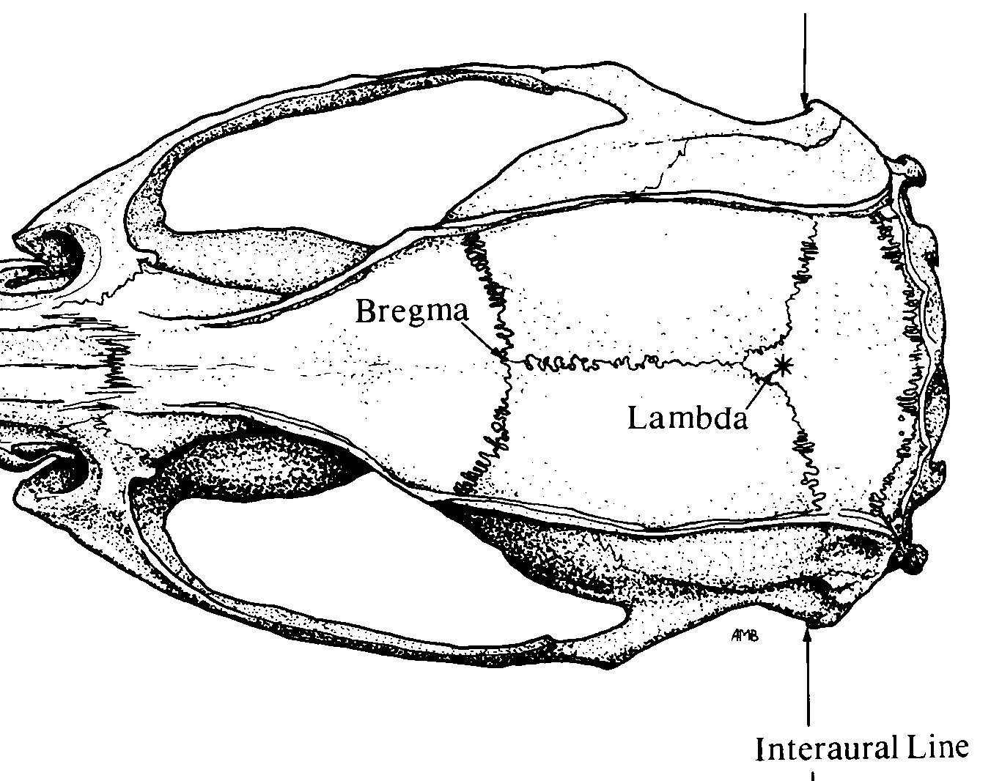

Custom Pinnacle Optrode 3-Channel layout
Implant Map
Pin-out
1 GND | 2 R-M1 (Chan2) | 3 EMG wire (Chan3)
4 Depth/Cannula | 5 Depth/Cannula (Chan1) | 6 EMG wire (Chan3)
White out
*
4/5
2
Bregma
Stereotaxic Coordinates
Location | Bregma | Midline
M1 | +1.5 (anterior) | ±2.0 (lateral)
EMG | Nuchal musc
Lambda
*
❶
3/6
Nuchal muscle
*
Anchor screw
Adjust ratio $=\frac{Measured X B−L}{Reference X B−L}$

